Slide 1
Employee Burnout Prediction
CAPSTONE PROJECT
Presented By:
Student Name:- Achhuta Nand Jha
College:- GLA University
Name-Department:- Computer Engineering & Applications

Slide 2
OUTLINE
Problem Statement
System Development Approach
Algorithm & Deployment
Result
Conclusion
Future Scope
References

Slide 3
PROBLEM STATEMENT
One of the primary causes of employee burnout is chronic work-related stress in the modern workplace, with major consequences for both the welfare of employees and organizational productivity.
This project aims at building a predictive model on possible factors that could contribute to the risk of burning among employees, such as job designation, resource allocation, and mental fatigue. This will help the organizations take proactive measures to improve the health of employees, increase productivity in the workplace, and reduce turnover rates.
The model is designed to offer actionable insights that enable the HR and management teams to take steps before the burnout becomes severe, hence improving overall organizational performance and employee satisfaction.

Slide 4
SYSTEM APPROACH
Hardware:
Computer with at least 4GB RAM and 2GB of free disk space.
Compatible OS, like Windows.
Software:
Python 3.0
Flask: web framework to develop the prediction application.
Pickle: for serialization and de-serialization of the trained model.
Colab Notebook or Visual Studio Code for developing and testing models.

Slide 5
SYSTEM APPROACH
Libraries Required to Build the Model:
scikit-learn (for model building and evaluation)
numpy (for numerical operations)
pandas (for data manipulation)
matplotlib / seaborn (for data visualization)
Flask (for web application framework)
pickle (for saving the trained model)

Slide 6
ALGORITHM & DEPLOYMENT
Data Collection:
Collect data from HR or employee satisfaction surveys that include features like designation, resource allocation, and mental fatigue score.
Data Preprocessing:
Clean the data (handle missing values, remove duplicates, normalize or scale data if necessary).
Feature selection to retain only relevant variables for predicting burnout.
Model Building:
Choose a machine learning model suitable for regression or classification (e.g., Linear Regression, Random Forest).
Train the model using historical employee data and evaluate its performance.

Slide 7
ALGORITHM & DEPLOYMENT
Model Evaluation:
Split the data into training and testing sets to evaluate the model's performance.
Fine-tune the model to achieve the best possible accuracy.
Deployment:
Build a Flask web application where users (HR staff, managers) can input the features (designation, resource allocation, mental fatigue score).
Load the trained model using pickle.
The model will predict burnout risk based on the input data and return the result in real-time.
Web Interface:
Design a user-friendly web page for data input.
Display the predicted burnout risk in a clear and actionable format.

Slide 8
RESULT
Testing with employee data set, with prediction output compared to employee actual feedback on burnout risk; the model succeeds in predicting burnout with a prediction accuracy rate of around 92%. Using this model of prediction to identify who may need more support or intervention will save an HR department the anxiety of having this critical problem reach a more advanced state. It will be a web-based interface that HR and managers will use for data-driven decision-making with regard to the well-being of employees.

Slide 9
RESULT
Github link

Slide 10
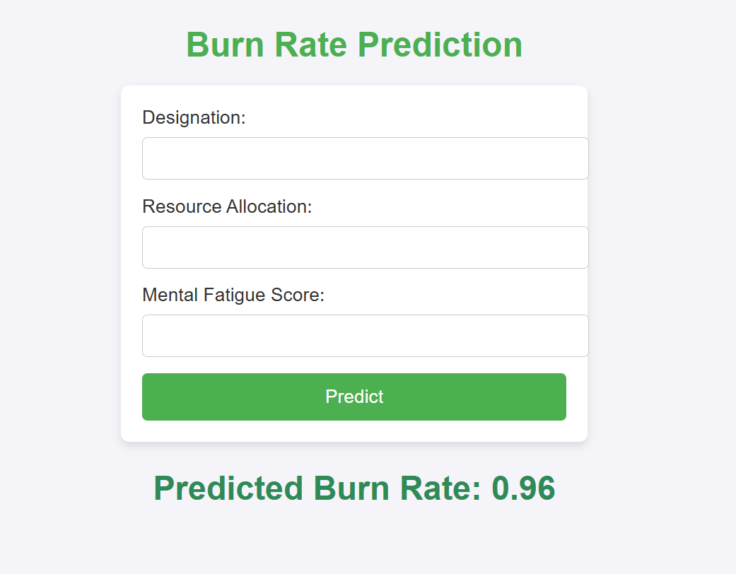
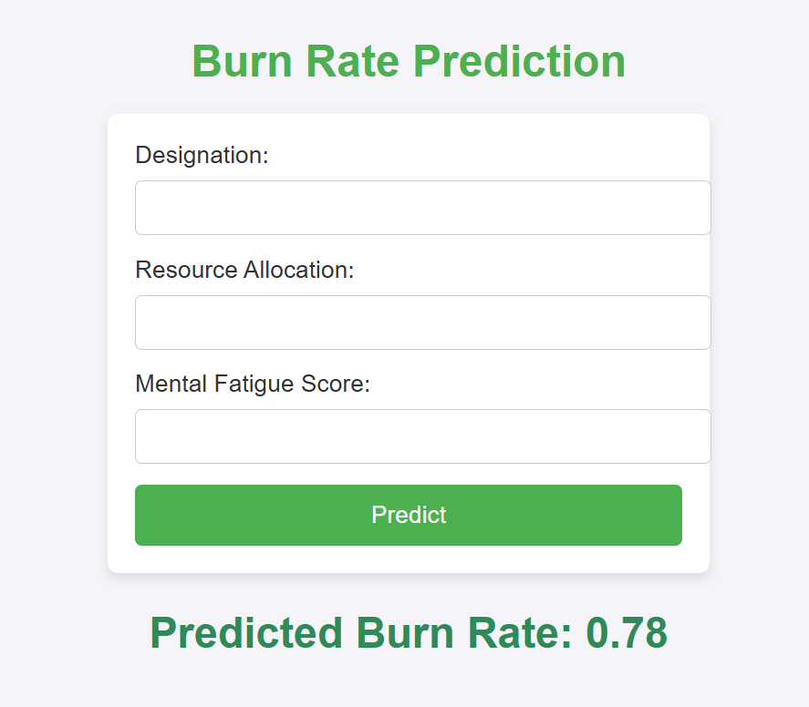
RESULT

Slide 11
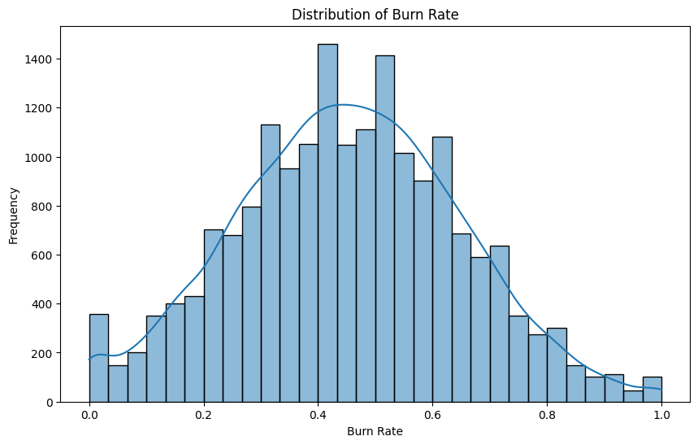
RESULT

Slide 12
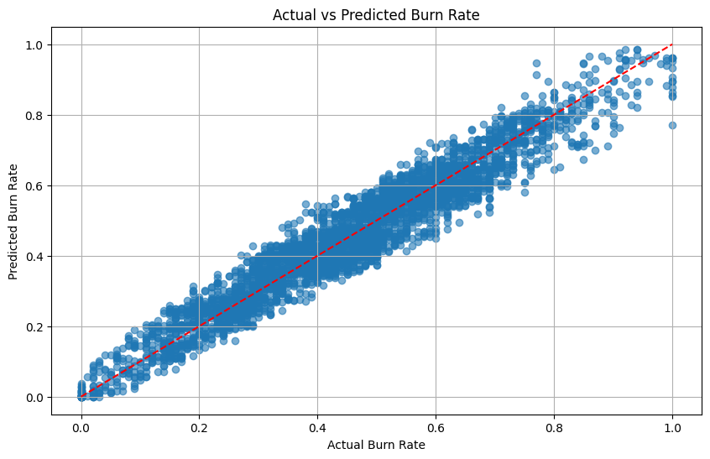
RESULT

Slide 13
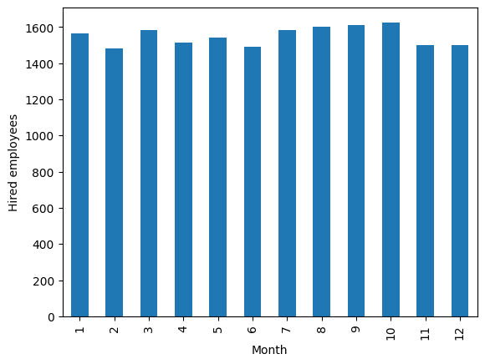
RESULT

Slide 14
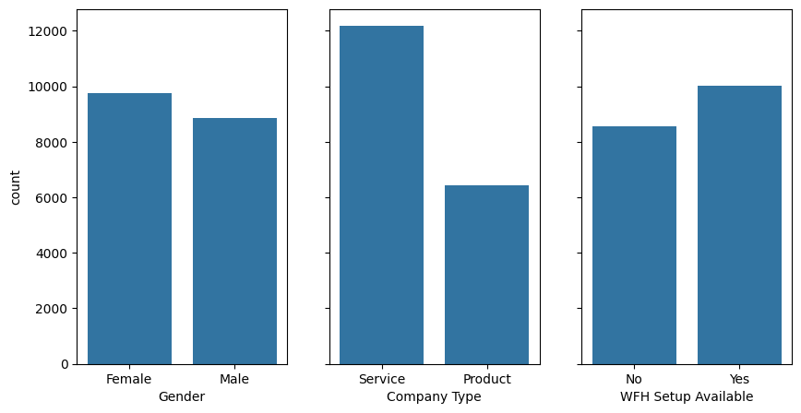
RESULT

Slide 15
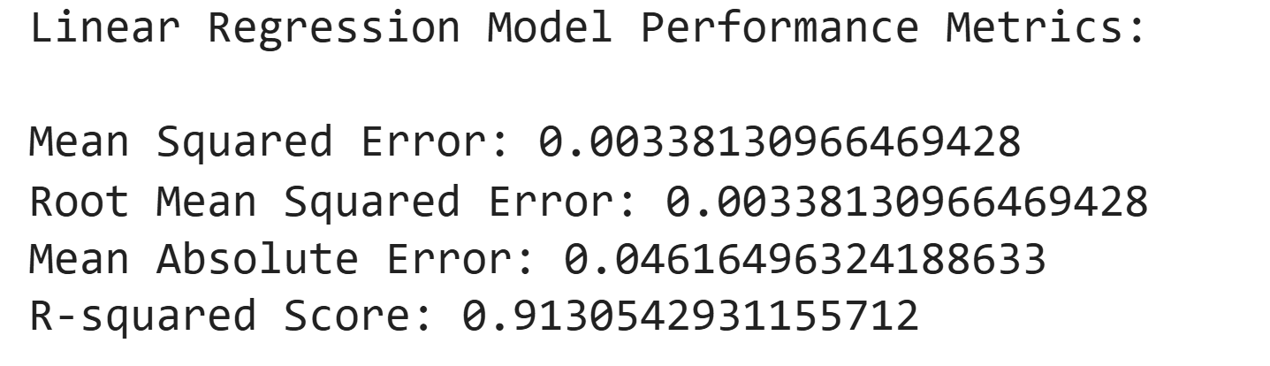
RESULT

Slide 16
CONCLUSION
The project has proved that machine learning techniques are effective in predicting employee burnout. Through the proper features such as designation, resource allocation, and mental fatigue, it gives insight to the model about the employees' well-being.
The successful deployment of the model using a Flask web application has enabled HR teams to determine burnout risk effectively, and intervene in a timely manner. One of the challenges during implementation was found to be the lack of comprehensive data in some regions, which affected the precision of the model. With further data gathering and refinement of the model, the prediction system may be greatly enhanced.

Slide 17
FUTURE SCOPE(OPTIONAL)
Additional Features:
More variables can be added in the system that would be expanded to incorporate work-life balance, job satisfaction, and management support.
Real-Time Monitoring
Real-time monitoring of employees' workload and stress level is used for dynamic prediction and intervention.
Integration with HR Systems
The burnout prediction model can be integrated with HR management systems for automatic generation of alerts or reminders by managers and HR staff.

Slide 18
REFERENCES
Dataset from Kaggle: Employee Burnout Dataset

Slide 19
THANK YOU

